Slide 1
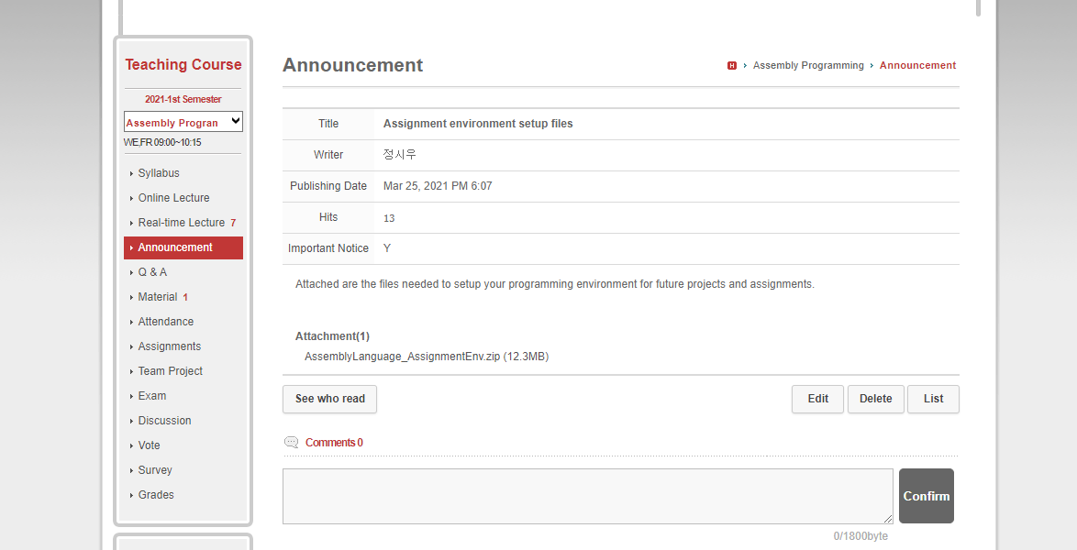

Visual Studio 2017 installation
Download the zip file from Cyber Campus Announcement
Download
Notes:
Hello,
In this video, I will give you a short tutorial on how to set up your programming environment for future projects and assignments.
First, as shown in the slide, download the vs_community installer.
You must use Visual Studio 2017 (and not other versions).

Slide 2
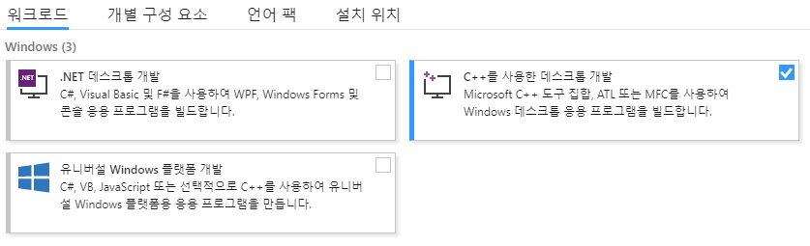
Visual Studio 2017 installation
WorkLoad tab => Check “Desktop Development with using C++”
Check
Notes:
After you download and execute the installer, you will arrive at this screen.
You should select the option “Desktop Development with using C++”.

Slide 3
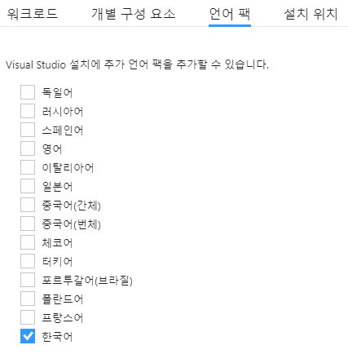
Visual Studio 2017 installation
(Optional) Language tab – Choose a language in which you are comfortable.
- Recommend Korean or English for later help from TA.
Notes:
There is an optional tab for languages.
I advise you to select Korean or English for when you might have questions with your assignments.

Slide 4
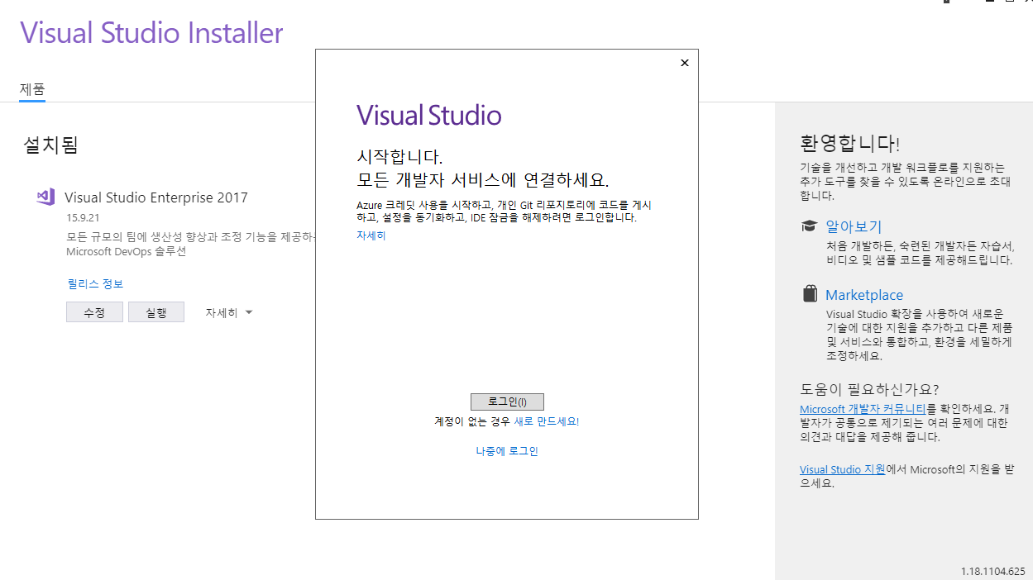

Visual Studio 2017 installation
You don’t need to Login, just skip(click “login later”).
Notes:
Once installation is complete, you may encounter a message telling you to log in.
You don’t need to login to use Visual Studio, so click on login later and proceed.

Slide 5
Microsoft Macro Assembler Setting
Download from Cyber Campus (same)
Download
Notes:
Next, you will have to install the file called Irvine. The download link is same as the Visual Studio installer.

Slide 6
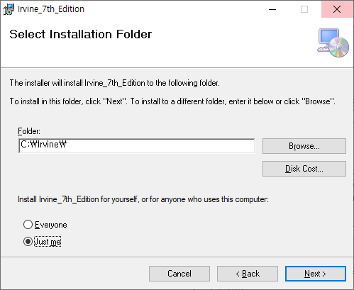
Microsoft Macro Assembler Setup
Execute the downloaded file, and set the path as C:\Irvine\
(the first letter of Irvine is capital i)
Notes:
Once you’ve downloaded and executed the file, this message will pop up.
Make sure to set the installation path as Irvine with a capital I, as shown in the slide.

Slide 7
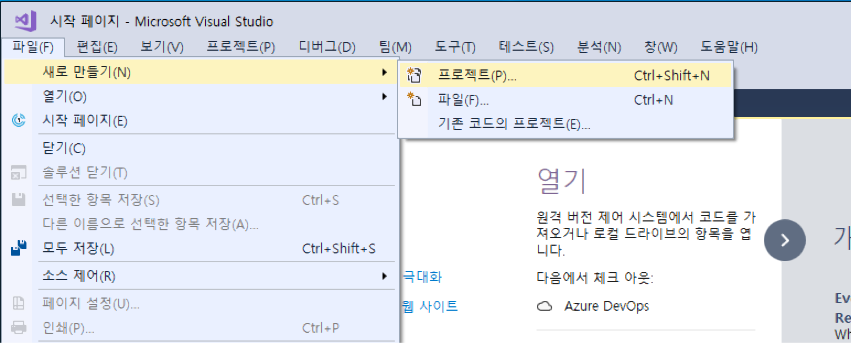
Visual Studio Project Setup
Execute Visual Studio 2017
Click File –> New –> Project (Hotkey : Ctrl+Shift+N)
Click!
Notes:
Next, we will look at how to make a project in Visual Studio that supports Assembly Language.
First, execute Visual Studio 2017.
Then, click the File menu, and under New, select Project.

Slide 8
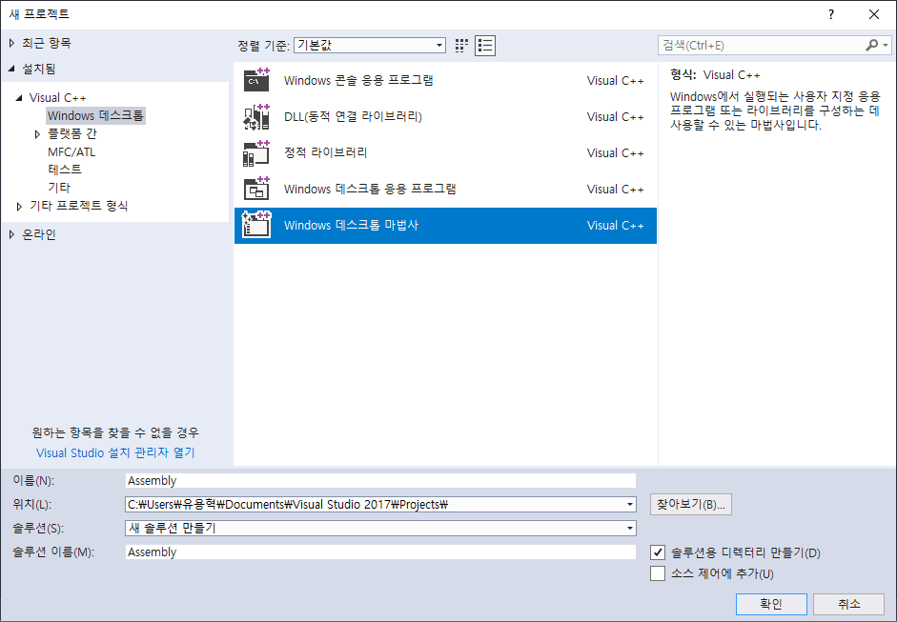
Visual Studio Project Setup
Visual C++ -> Windows Desktop -> Window Desktop Wizard
(1)
(2)
(3)Set the Project Name
(4)
Notes:
On the left, under Visual C++, select Windows Desktop.
Then, click on Windows Desktop Wizard and select your project name.

Slide 9
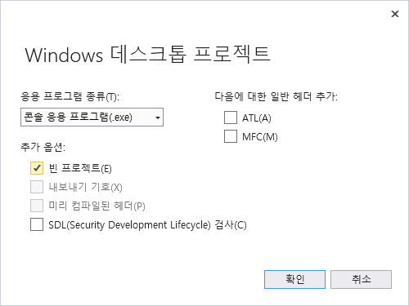
Visual Studio Project Setup
Console application –> Empty Project (SDL is optional)
Notes:
Within the pop-up, make sure to select Console Application and check the Empty Project option.
SDL is optional, but I personally would not recommend using it.

Slide 10
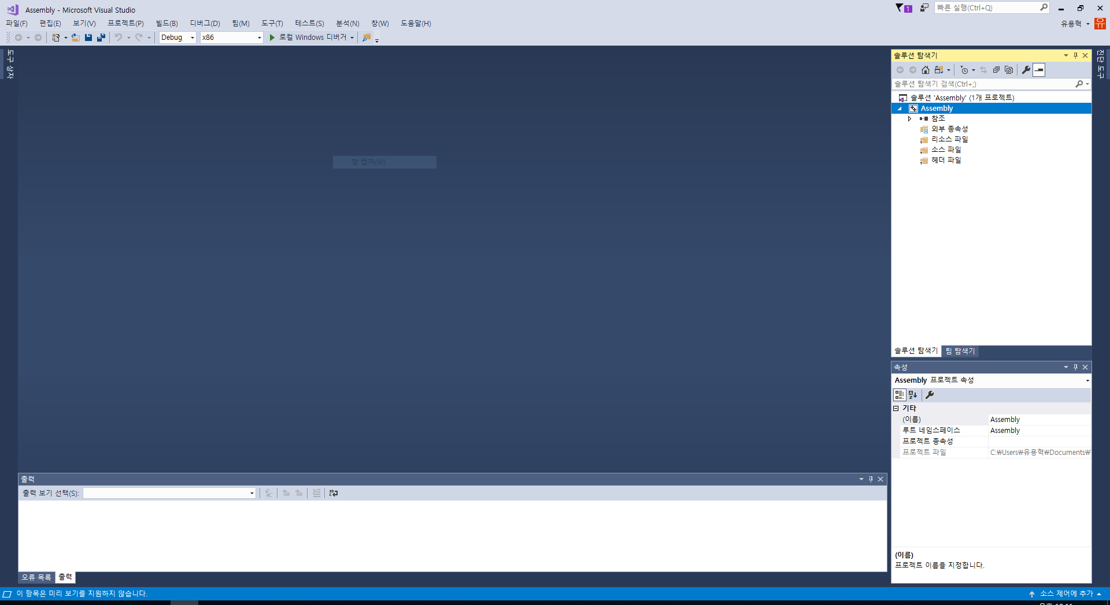
Visual Studio Project Setup
Screen right after creating a new project.
Notes:
Once you created a new project, you will see something like this.

Slide 11
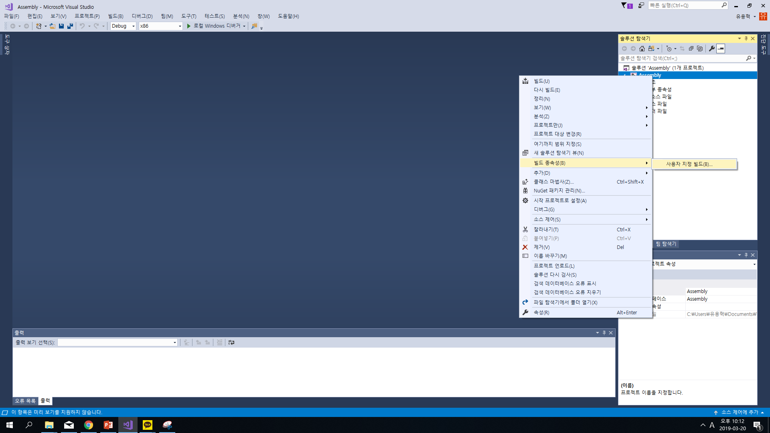
Visual Studio Project Setup
Project –> Build Dependency(빌드 종속성) – Build Customization(사용자 지정 빌드) Click
Right Click!
Notes:
We need to set the build dependency.
Right click your project on the right and go to Build Dependency, Build Customization

Slide 12
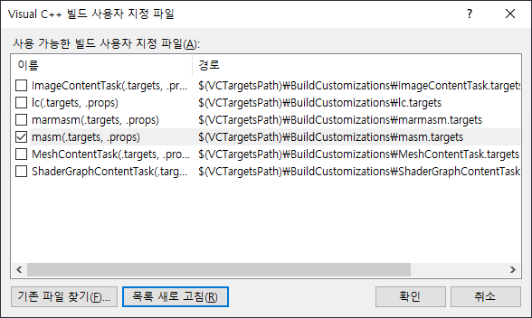
Visual Studio Project Setup
Check masm and confirm
Notes:
Check masm and confirm

Slide 13
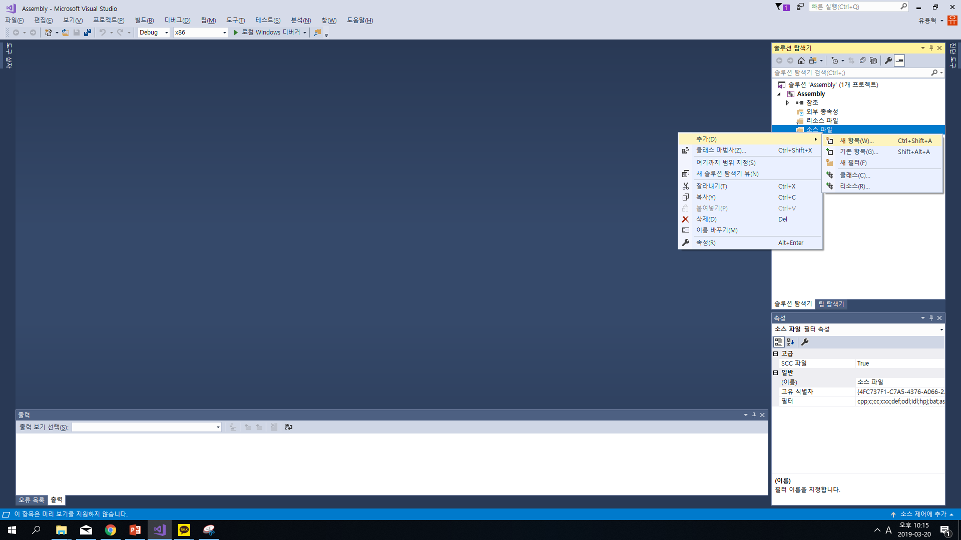
Visual Studio Project Setup
Adding New source code file.
Source file directory(소스파일) –> Add(추가) –> New item(새 항목)
Right Click!
Notes:
To add a new source code file, right click source file directory on the right, go to Add and click New Item.

Slide 14
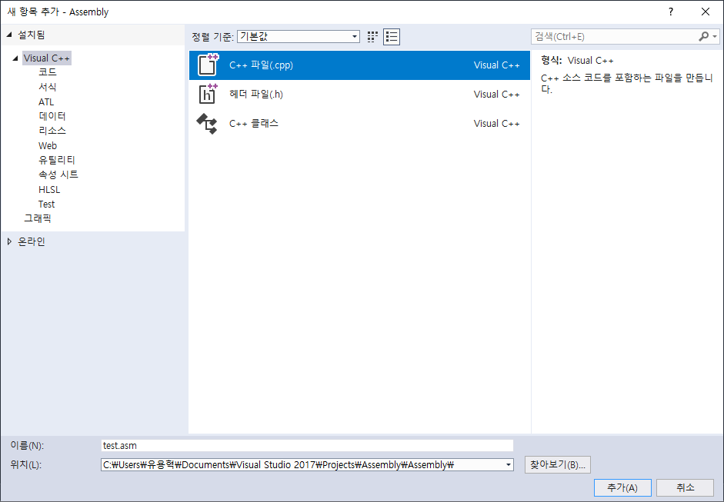
Visual Studio Project Setup
C++ File(.cpp) –> change filename extension as .asm(파일 확장자명 변경)(e.g. test.asm)
Make sure that the file extension is “.asm”
Notes:
Select CPP file and change the file extension to .asm

Slide 15
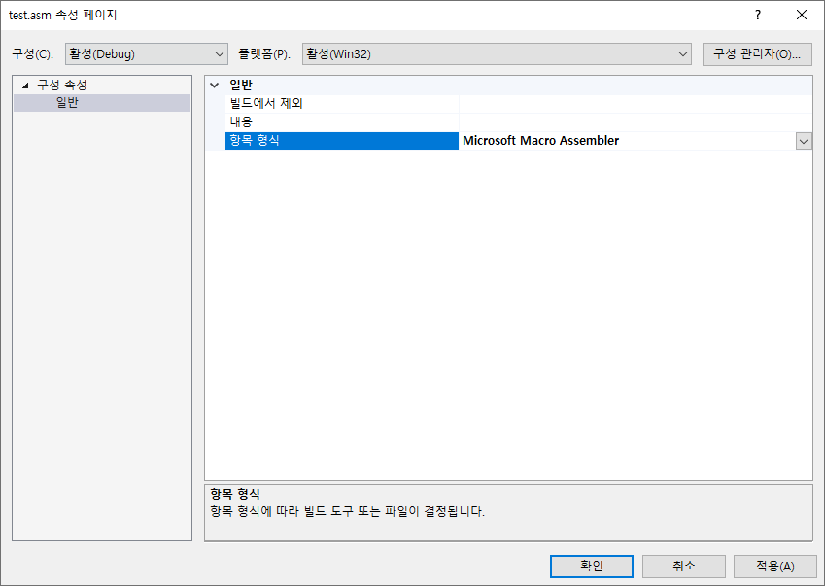
Visual Studio Project Setup
Right click the newly added .asm file –> 속성(properties) –> 항목 형식(item Type) –>
Microsoft Macro Assembler
Notes:
Right click the newly added .asm file and go to Properties, Item Type.
Select Microsoft Macro Assembler

Slide 16
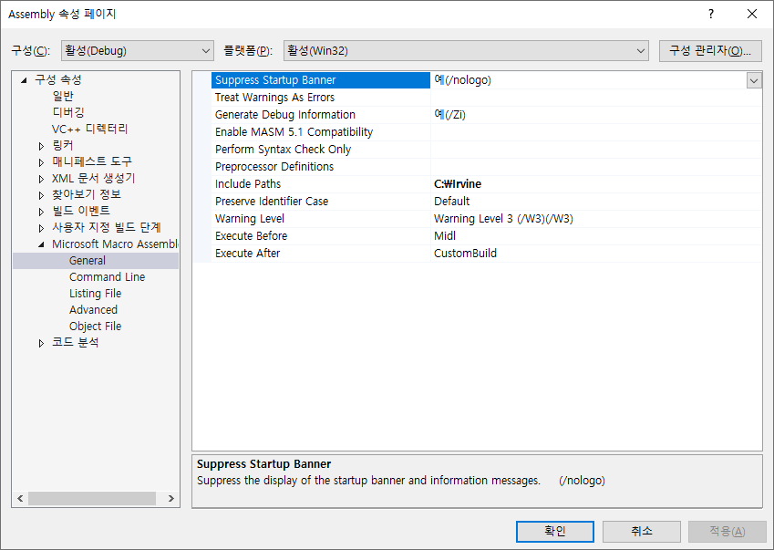
Visual Studio Project Setup
프로젝트(Project) –> 속성(properties) –> Microsoft Macro Assembler -> General –> Include Paths –>Add C:\Irvine (the first letter of Irvine is capital i)
Notes:
Next, right click on your Project again, go to Properties.
Under Microsoft Macro Assembler, General, Add the directory you used for Irvine library in Include Paths.

Slide 17
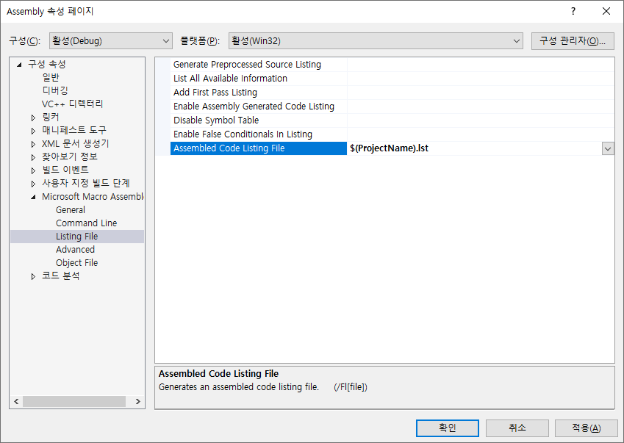
Visual Studio Project Setup
프로젝트(Project) –> 속성(Properties) –> Microsoft Macro Assembler –> Listing File –> Assembled Code Listing File -> $(ProjectName).lst
Notes:
Again, under Microsoft Macro Assembler, select Listing File.
Add ‘$(ProjectName).lst’ in Assembled Code Listing File.

Slide 18
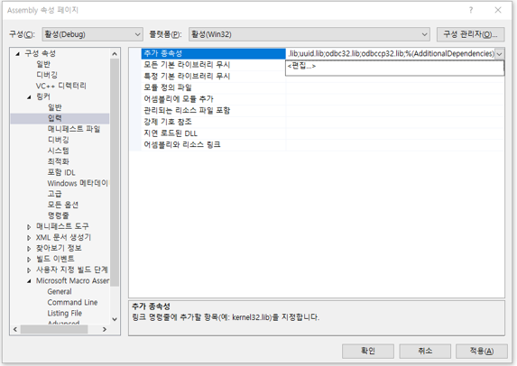
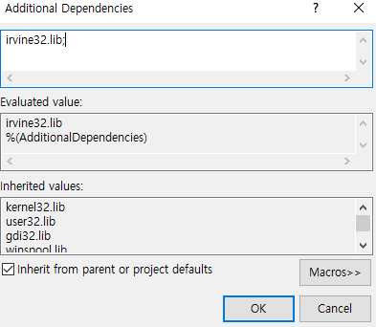
Visual Studio Project Setup
프로젝트(Project) -> Properties –> 링커(linker) –> 입력(Input) –> 추가 종속성(Additional Dependencies) –> 편집(Edit) –> irvine32.lib;
(2) Type yourself
(1) Click <edit..>
Notes:
Next, under Linker, select Input.
In the Additional Dependencies, click edit and add ‘irvine32.lib;’

Slide 19
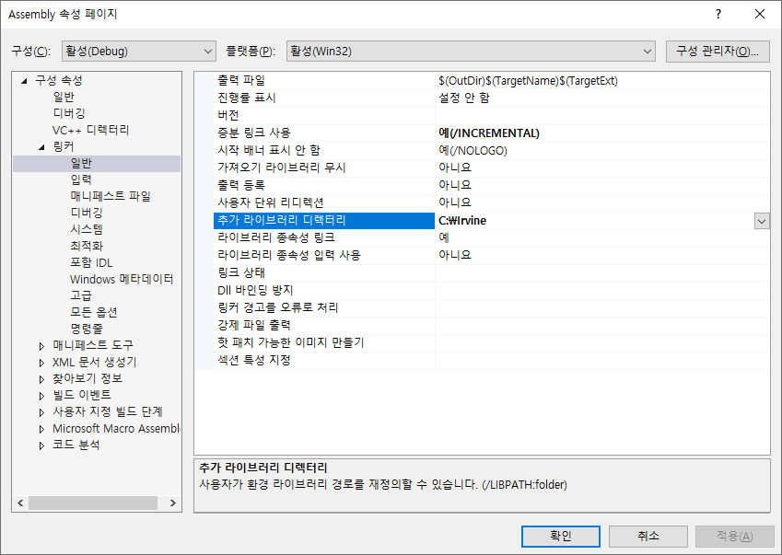
Visual Studio Project Setup
프로젝트(Project) –> 속성(Properties)-> 링커(linker) –> 일반(General) –> 추가 라이브러리 디렉터리(Additional Library Directories) –> C:\Irvine
Notes:
Still under Linker, select General.
Add the Irvine directory path in Additional Library Directories.

Slide 20
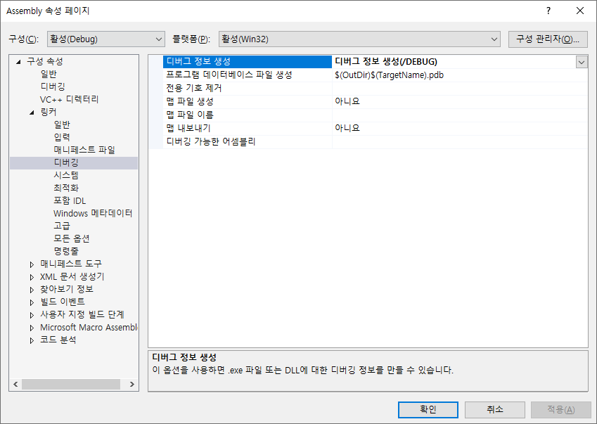
Visual Studio Project Setup
프로젝트(Project) –> 속성(properties) –> 링커(linker) –> 디버깅(debugging) –> 디버그 정보 생성(Generate Debug Info) – 디버그 정보 생성(/DEBUG) {Generate Debug Information(/DEBUG)}

Slide 21
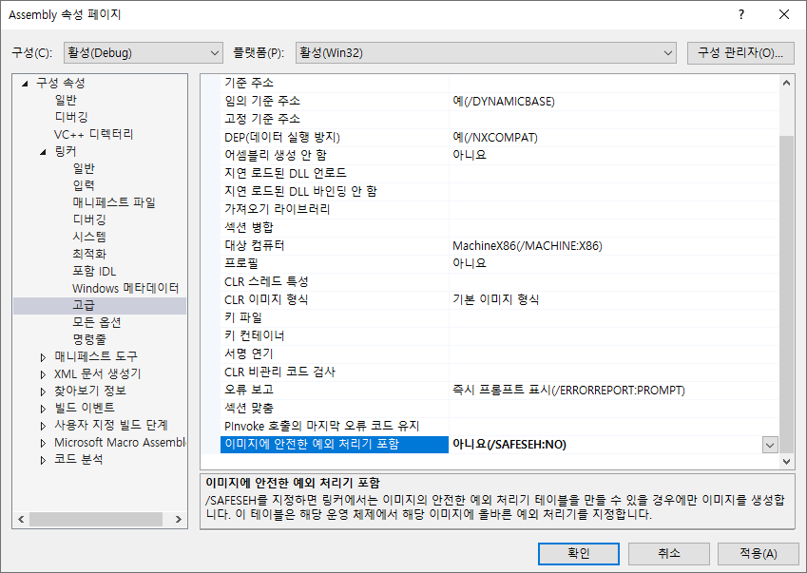
Visual Studio Project Setup
프로젝트 선택(Project) –> 속성(Properties) –> 링커(linker) –> 고급(Advanced) – 이미지에 안전한 예외 처리기 포함(Preserve Last Error Code for Pinvoke Calls) –> 아니요(Disabled) 선택

Slide 22
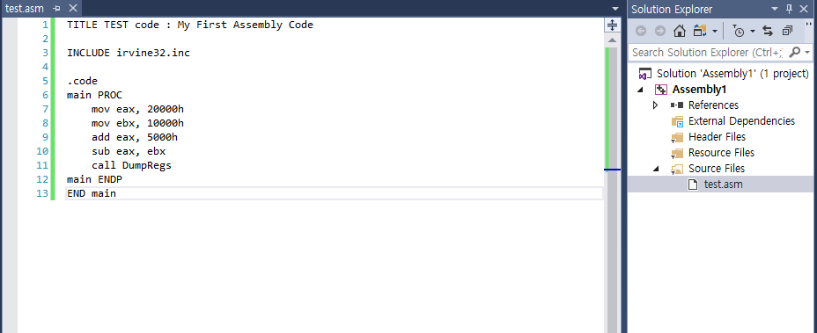
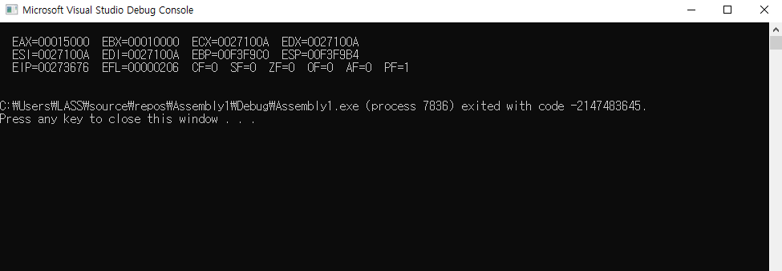
Make a Test program!
이전에 만든 파일(.asm 파일)에 다음과 같은 코드 작성 후 실행 (ctrl + F5) 후 결과가 나오는지 확인
Write code as follow , and execute it(ctrl + F5). Check the program runs successfully.
Ctrl + F5
If Success, Console prompt will appear as above

Slide 23
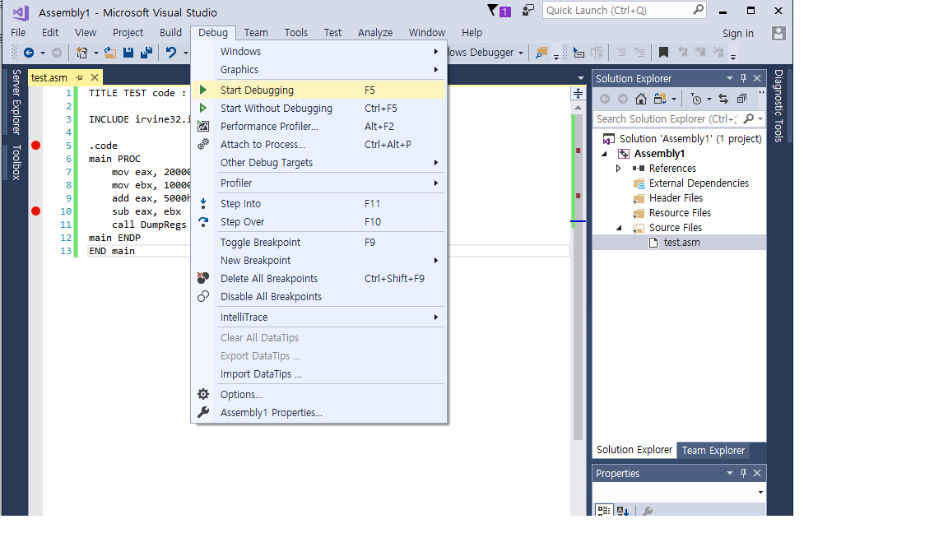
Debugging
(1) Set Breakpoints
- Type <F9> at the line you want.
(2) Run program as debug mode
- Type <F5> or 상단의 [디버그 – 디버깅 시작]
Click the line you want to check
Type <f5> key
then Red Circle appear at left side of the line

Slide 24
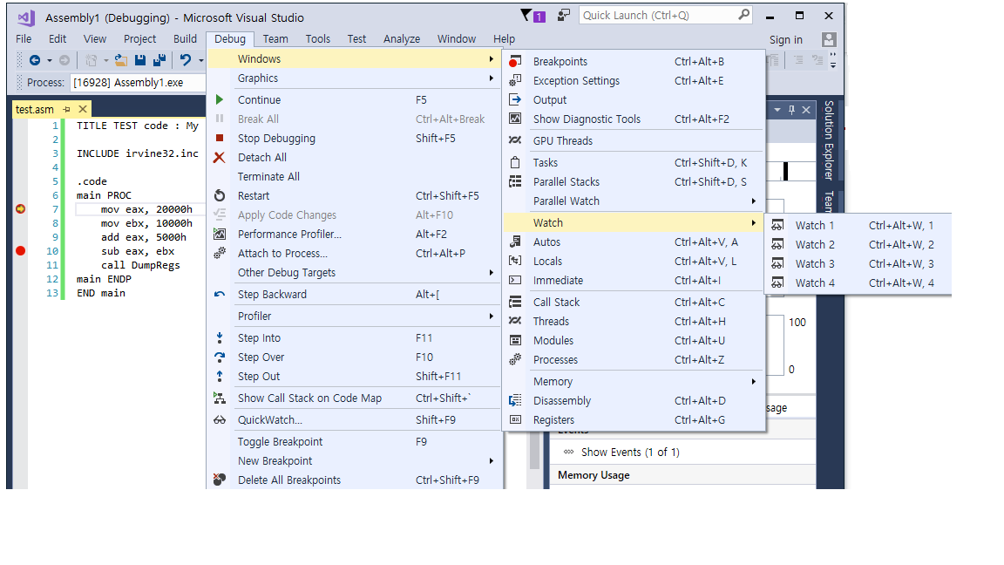
Debugging
After Running program with Debug mode
조사식: 디버그 –> 창 –> 조사식 또는 자동 선택
Watch: Debug –> Windows –> Watch or Autos

Slide 25
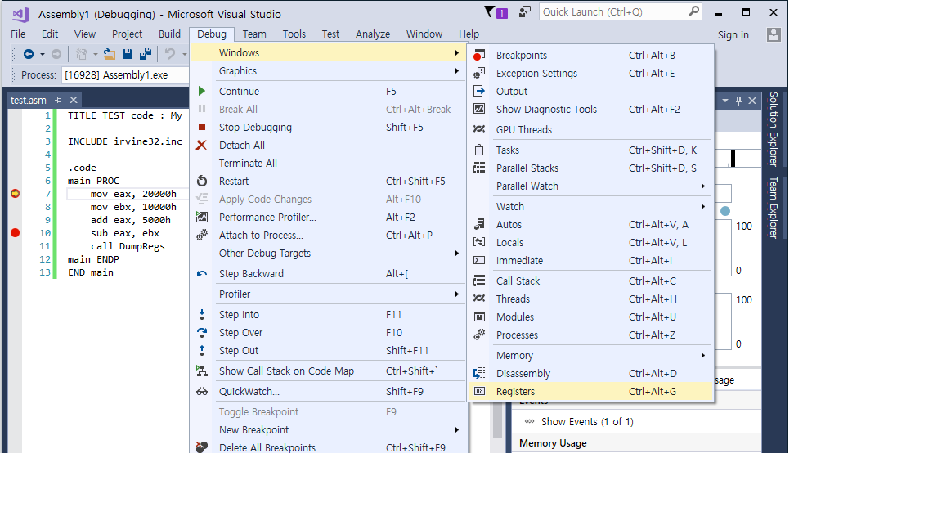
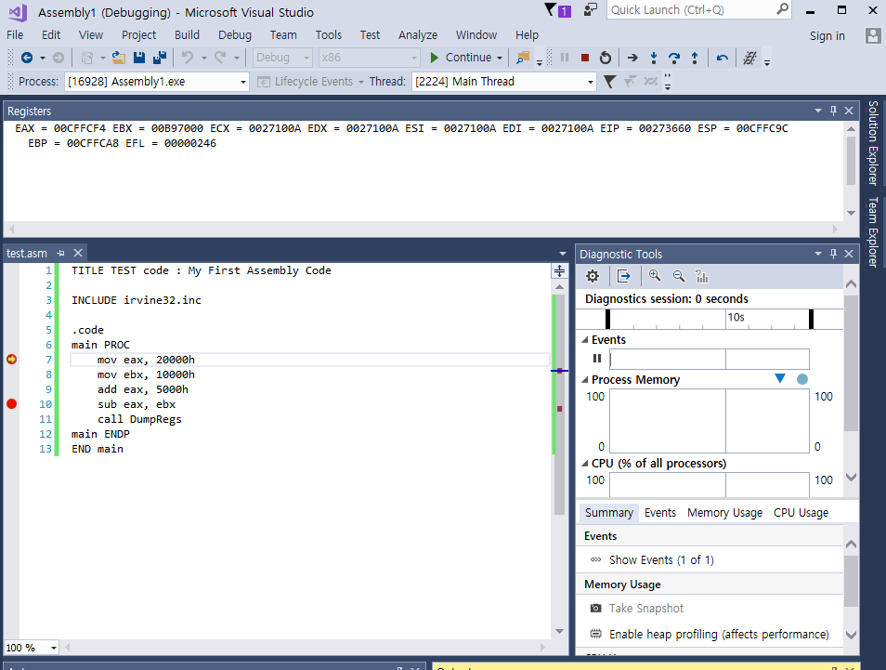
Debugging
디버깅 실행 후
조사식: 디버그 – 창 – 조사식 또는 자동 선택
레지스터: 디버그 – 창 – 레지스터 선택
Register Status : Debug->window -> register

Slide 26
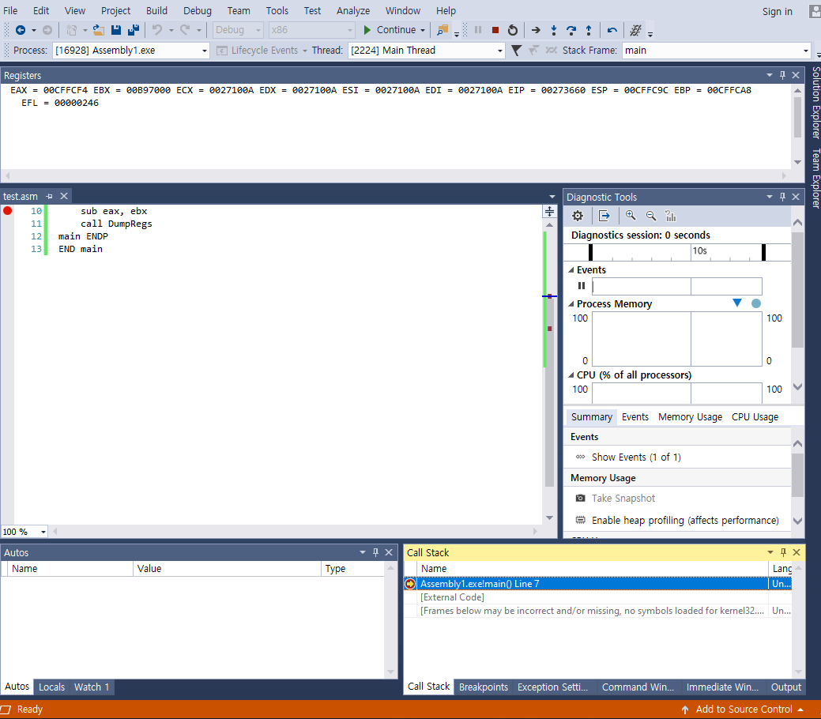
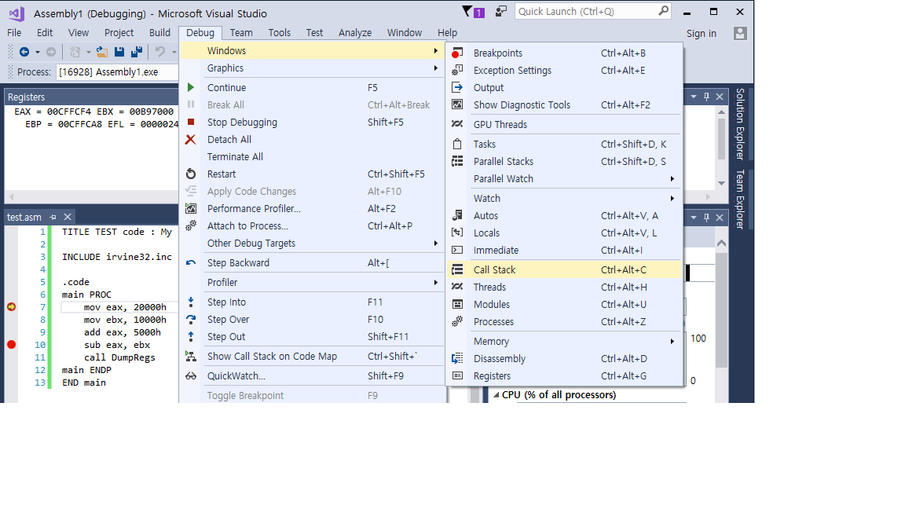
Debugging
디버깅 실행 후
조사식: 디버그 – 창 – 조사식 또는 자동 선택
레지스터: 디버그 – 창 – 레지스터 선택
호출 스택: 디버그 – 창 – 호출 스택

Slide 27
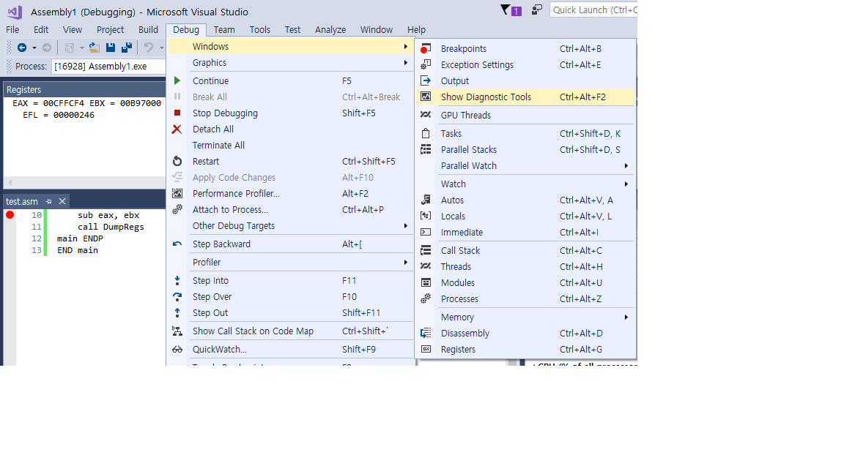
Debugging
디버깅 실행 후
조사식: 디버그 – 창 – 조사식 또는 자동 선택
레지스터: 디버그 – 창 – 레지스터 선택
호출 스택: 디버그 – 창 – 호출 스택
진단 도구: 디버그 – 창 – 진단 도구
Diagnostic Tool : Debug – Windows – Show Diagnostic tool

Slide 28
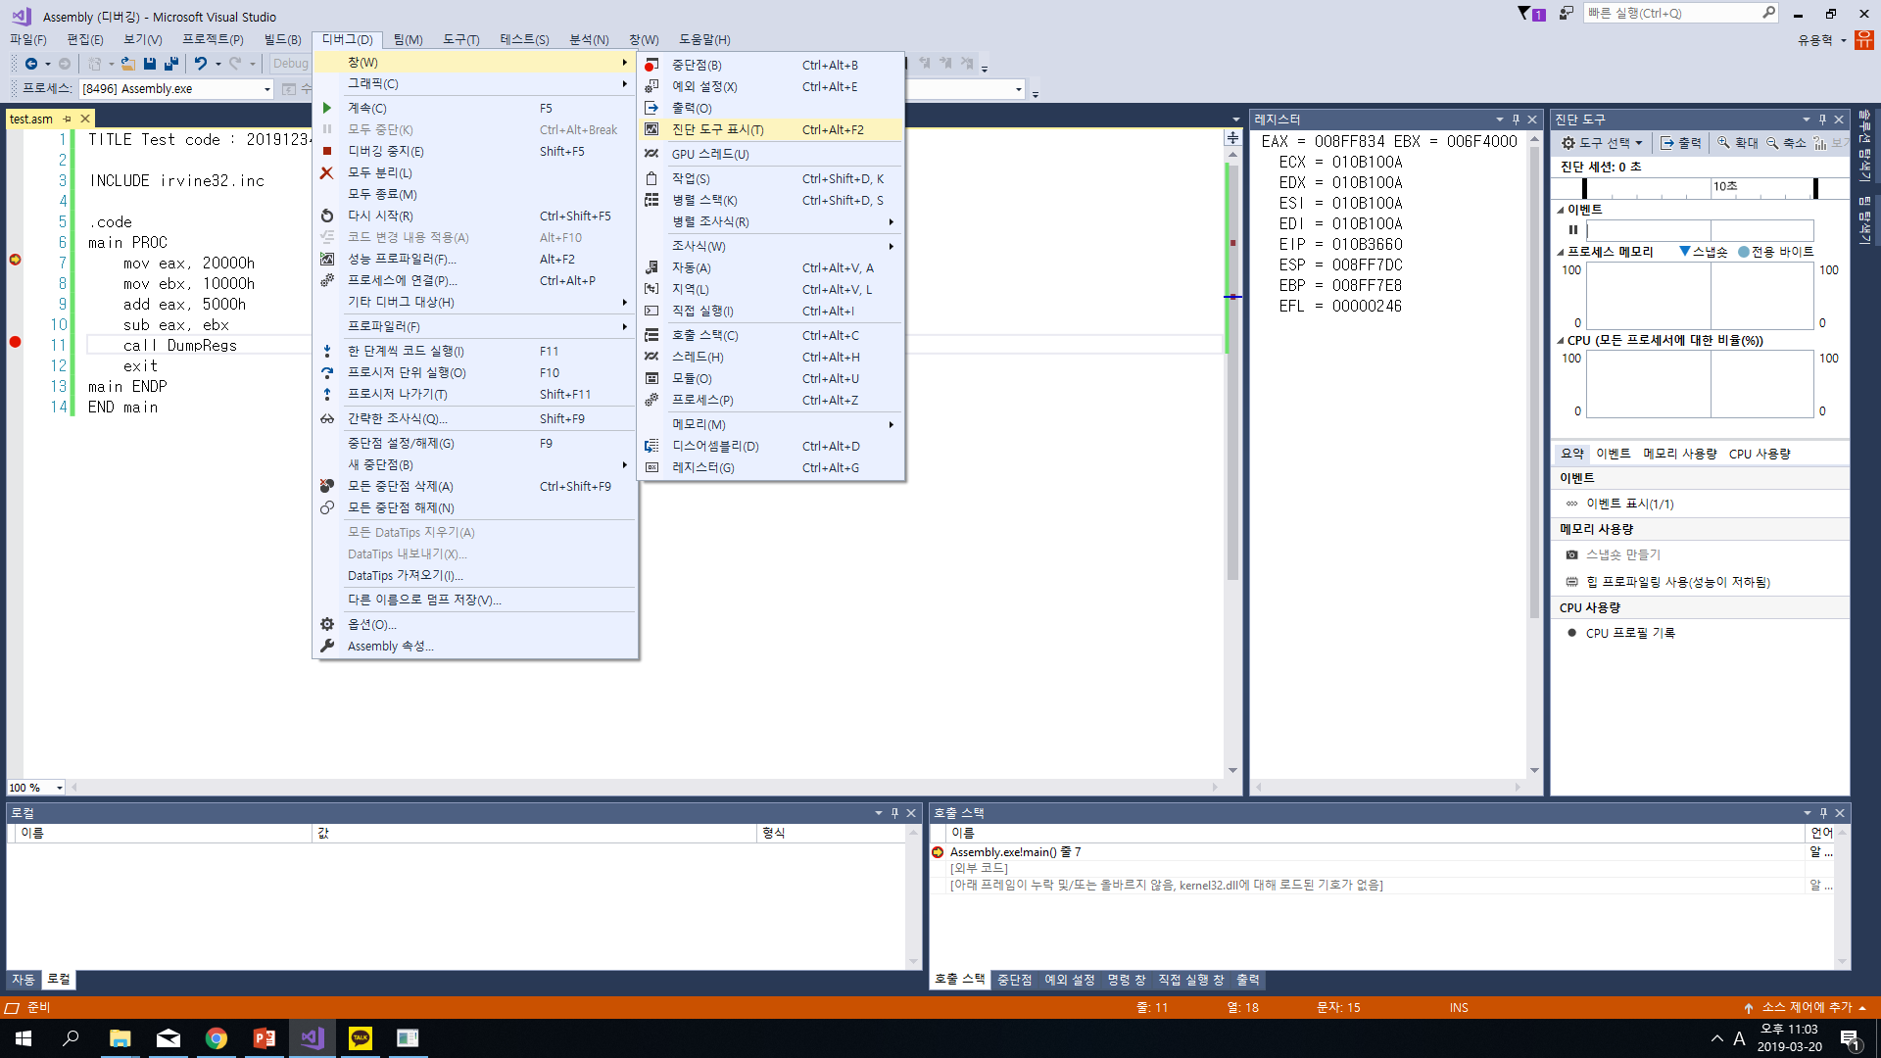
Debugging
디버깅 실행 후
조사식: 디버그 – 창 – 조사식 또는 자동 선택
레지스터: 디버그 – 창 – 레지스터 선택
호출 스택: 디버그 – 창 – 호출 스택
진단 도구: 디버그 – 창 – 진단 도구

Slide 29
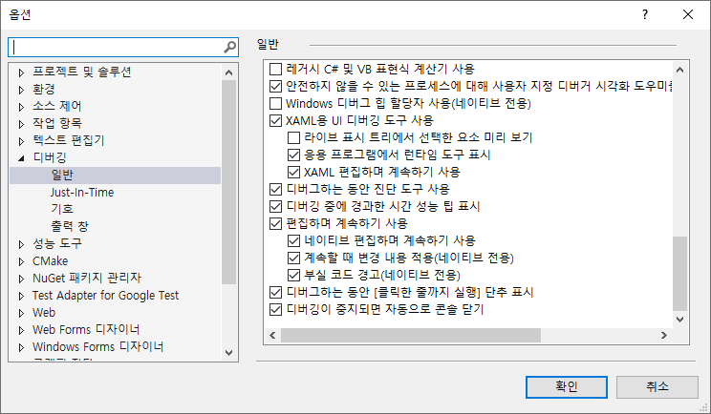
More…
최신 Visual Studio 2017에서는 프로그램 종료 시 ‘0 코드로 인해 종료되었습니다.’ 라는 메시지가 뜸.
정상적으로 종료되었다는 메시지지만 해당 메시지를 보고 싶지 않다면 디버그 – 옵션 – 디버깅 – 일반 – 디버깅이 중지되면 자동으로 콘솔 닫기 체크
Latest Visual Studio 2017, ‘ConsoleApplication has exited with code 0 (0x0)’ message prompt after program ends.
If you don’t want to see the message,
Debug – option – debugging – general – ‘automatically close the console when debugging stops’

Slide 30
More tips…
https://gyoran.tistory.com/47

